Slide 1
HOME OF A FINANCIALLY SECURE FAMILY
WITH FINANCIAL EDUCATION
*Internal Use Only
Notes:
Change color of grey ‘
Lines adjust
Family home, white line missing
Provides shelter
9 percentage theek kro
9% people take benefit of all these --- then roof
Last– animation theek kro
1

Slide 2
After Understanding This,
What Do You Think Is Most Important for
your family?
HOME OF FINANCIALLY SECURE FAMILY
Understand Tax Implications Before Planning
Understand How To Transfer Wealth To Next Generation
Tax Efficiencies
Estate Planning
Once Paid Off
T.W.O
T.W.O
T.W.O If Structured Properly
After Tax Money Goes In
After Tax Money Goes In
Few People Take Benefit of All This
Building
A Foundation
(Protecting Income)
Pillars
(Saving Vehicles)
Roof
(Efficiencies & Estate Planning)
Majority People put money in these 2 only
UL & WHOLE LIFE
WEALTH STRATEGY
FAMILY HOME
RRSP
FHSA
NON-REG
TFSA
N T.W.O
N T.W.O
Puts Roof On Your Home Overtime As Well
Money Grows over 10/15 Years if invested
Can
Grows Upto
15 years
20/25 years to pay off
Access Tax Free But Only Be Used For First Time Home Down Payment
Money Grows If Invested
Only Beneficial If Money Grows
Money Grows If Invested
.
Money Grows Over Long Term
Foundation Of Financial Home Is Your Ability To Earn Income
C.G
Options to Takeout in A Tax preferred way
What Could Destroy The Foundation?
OR
Provides Shelter But No Income
100% Taxable when comes out
Max. Contribution $40,000
50% Taxable
50% Tax-free
When Comes Out
NO TAX When Comes Out
Ø
ALL OF THEM TOGETHER WITH
UNIVERSAL LIFE & WHOLE LIFE PLAN
This Is Why Foundation Safety Is Most Important
Ability To Earn Income
Protect Foundation In The Beginning
DEATH
DISABILITY
CRITICAL ILLNESS
Notes:
Change color of grey ‘
Lines adjust
Family home, white line missing
Provides shelter
9 percentage theek kro
9% people take benefit of all these --- then roof
Last– animation theek kro
2

Slide 3
PERSONAL LIFE PROTECTION
RENTAL (Term)
OWNERSHIP (Permanent)
TERM PROTECTION
PERMANANT PROTECTION
Savings
10 YEARS
20 YEARS
30 YEARS
LIFETIME COVERAGE
ONE DAY TAX-FREE TO THE FAMILY
INVEST
GROW
PAY-OFF EARLY
USE ON A TAX-PREFERRED BASIS
Less premium & Specific time Protection
Expensive upon renewal
No Savings
Benefit:
Drawbacks:
Which one would you like to know more about?
RENTAL OR OWNERSHIP

Slide 4
Whole Life vs Universal Life
Types | Whole Life | Universal Life
Cost of Insurance | Fixed | Yearly Renewable/Level
Growth | Guaranteed + Dividend | Variable but Managed
Premium | Fixed Premium | Flexible Premiums
Pay Period | 10 year, 20-year or Till age 100 | 20, 25, 30 (Flexible)
Tax deferred growth/ Tax Free inheritance | Yes | Yes
Would you like to have Guaranteed Growth & Fixed Premiums or Variable Growth & Flexibility?

Slide 5
Solution - Universal Life
Income protection
While you are working, UL provides income protection for your family. If something unexpected should
happen to you, your family will be provided for. Plus...you can include a critical illness protection rider on your universal life insurance policy for an added layer of protection.
Investment growth
UL offers a variety of investment options which are professionally handled by best-in-class money managers so you can customize the coverage that reflects your personal investment goals at every stage of life. As well, UL offers many guarantees to ensure you are getting the most out of your investments including Guaranteed Cost of Insurance (COI) rates.
Tax‐deferred growth
UL offers you the power of tax‐deferred growth on your investments so that more of your money stays with you.
Discipline
UL is designed to encourage disciplined investing throughout your life. In fact, it will reward you for making consistent minimum premium payments through a Persistency and Performance Bonus.

Slide 6
Building & Protecting your Future - Client
Power of small consistent savings
What better do we get in $20/day ??
And in a day?
How much a month?
Saving $7.6/day
$230/m
=$230 x 12 = $2760/year
=$2760 x 30yrs
=$82,800 total saving
How much a year?
But how much did you put in total?
While you are saving for your own future, for next 30 years you are also protected for
$750,000
After 30 years @6% growth
=$118,000
At age 65, total Savings for your retirement
=$145,000
To protect your savings, you have
$100,000
of Critical Illness Protection
Till Age 65 within the plan
No Input after 30yrs,
But money still keeps growing
How many people out of 10 get diagnosed with Heart Attack, Cancer, Stroke etc.?
4 ? 5?
How many till age 65?
7? 8? Out of 10
When people suffer an Illness, their income suffers and they,
Dig into their Savings
Take Debt (CC/LOC)
Sell Assets
Go Fund Me
Borrow from Friends/Family
All this you are getting while you saved for your own future.
How much did you end up saving for your Retirement?
$250,000
For the Rest of the Life
Which will be given to your family, god forbid if something happens after 30 years
As a result, will their stress go up or down?

Slide 7
Building & Protecting your Future - Client
Power of small consistent savings
What better do we get in $20/day ??
And in a day?
How much a month?
Saving $20/day
600/m
=$600 x 12 = $7200/year
=$7200 x 30yrs
=$216000 total saving
How much a year?
But how much did you put in total?
While you are saving for your own future, for next 30 years you are also protected for
$1618000
After 30 years @6.5% growth
=$417000
At age 65, total Savings for your Retirement Wealth
=$490,000
No Input after 30yrs,
But money still keeps growing
All this you are getting while you saved for your own future.
How much did you end up saving for your Retirement?
$800000
Generational Wealth
Which will be given to your family, God forbid if something happens after 30 years

Slide 8
Building & Protecting your Future - Client
Power of small consistent savings
What better do we get in $3.3/day ??
And in a day?
How much a month?
=$100 x 12 = $1200/year
=$1200 x 30yrs
=$36,000 total saving
How much a year?
Saving $3.3/day
$100/m
But how much did you put in total?
While you are saving for your own future, for next 30 years you are also protected for
$100,000
After 30 years @6.5% growth
=$74,860
At age 65, total Savings for your retirement
=$153,770
To protect your savings, you have
$25,000
of Critical Illness Protection
For 10 yrs within the plan
This plan also includes
Will Prep on ongoing basis
Life Protection (Paid out in 24 hrs)
Virtual Vault to store all docs
Concierge Services (Through tough times)
In case of emergency does your family know where are the important documents ?
Protection Plans
Personal Secure Info
Incorporation Docs
Real Estate
All other investments
God forbid something happens, who is beneficiary of bank accounts, vehicles, properties, corporations & other investments?
Who will be the trustee for minor children (if any) in case of any tragedy ?
Do you have an updated
will in place ?
No Input after 30yrs,
But money still keeps growing
How many people out of 10 get diagnosed with Heart Attack, Cancer, Stroke etc.?
4 ? 5?
How many till age 65?
7? 8? Out of 10
When people suffer an Illness, their income suffers and they,
Dig into their Savings
Take Debt (CC/LOC)
Sell Assets
Go Fund me
Borrow from Friends/Family
All this you are getting while you saved for your own future.
How much did you end up saving for your Retirement?
$100,000
For the Rest of the Life
Which will be given to your family, god forbid if something happens after 30 years
As a result, will their stress go up or down?

Slide 9
Solution – TFSA
Power of small consistent savings
Lump Sum
$2,000
Every bi-weekly Paycheque
$200/m
@6% Growth
Savings in 5 Years
$31,555
Do you see any reason why you want to continue using your savings/checking account to save money for short term and for Emergency Funds ?
Do you want to increase your savings per paycheque decrease it or keep it the same ?

Slide 10
Solution – RRSP
Power of Savings
Lump Sum
$10,000
Every bi-weekly Paycheque
$500/m
@6% Growth
Savings in 2 Years
$38,842
Tax Returns
$7,000
Total Savings for down payment
$45,842
Do you see any reason why you want to continue using your savings/checking account to save money for down payment?

Slide 11
Kids Future Planning
RESP Bonus Plan
Kids Plan
- Only below 4 years of age
20% Govt Grant upto $7,200 per child
Can be used for any purpose such as business, house, marriage, retirement etc.
Both your money & grant money can be invested
Grows long term with cash dividends
Used for Education related expenses only
Child is protected from day 1 for the rest of the life
15% Bonus for consistent contribution (till age 17)

Slide 12
Government Grant
$400/m
$200 – RESP Bonus
$200 – Wealthy Child Plan

Slide 13
RESP Bonus Plan
By Contributing a part of the government grant you received
You created a wealth of $86,151 for

Slide 14
Wealthy Child Plan – Creating Generational Wealth
You contribute $200/month for 20 years towards Child’s whole life plan.
In 20 years you contribute a total of 20 X 12 X $200 = $48,000
Age
Goal
Approx. Savings
Protection
23
Education
$57,000
$335,000
28
Marriage
$75,000
$400,000
35
House/Business
$110,000
$500,000
65
Retirement
$565,000
$1,000,000
Total saving of $200 per (from govt grants) will create wealth for Generations

Slide 15
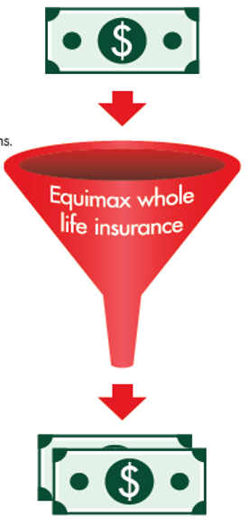
Wealthy Child Plan – Creating Generational Wealth
Alternate way of using the cash in the wealthy child plan
Would you like to use CTB for 18 years or
Potentially rest of the life??
PAY $2,400 in premiums
each year for years 1-20
CREATE a stable investment with
tax-advantaged growth.
WITHDRAW up to $4,600 each
year for years 26-100!

Slide 16
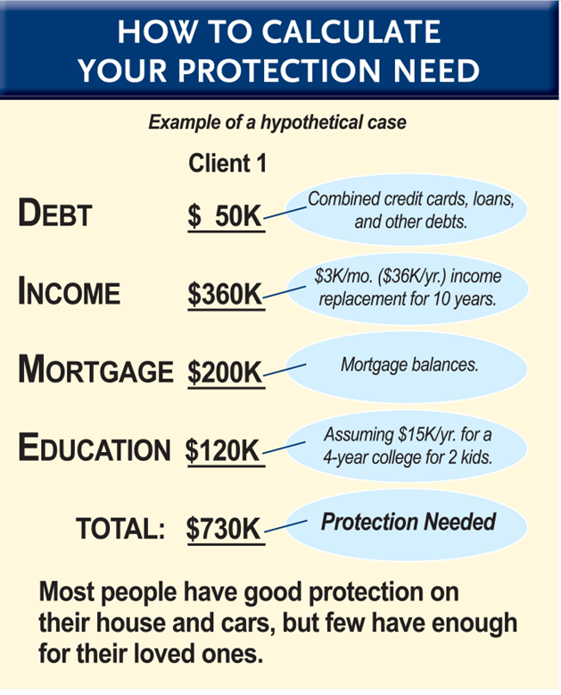
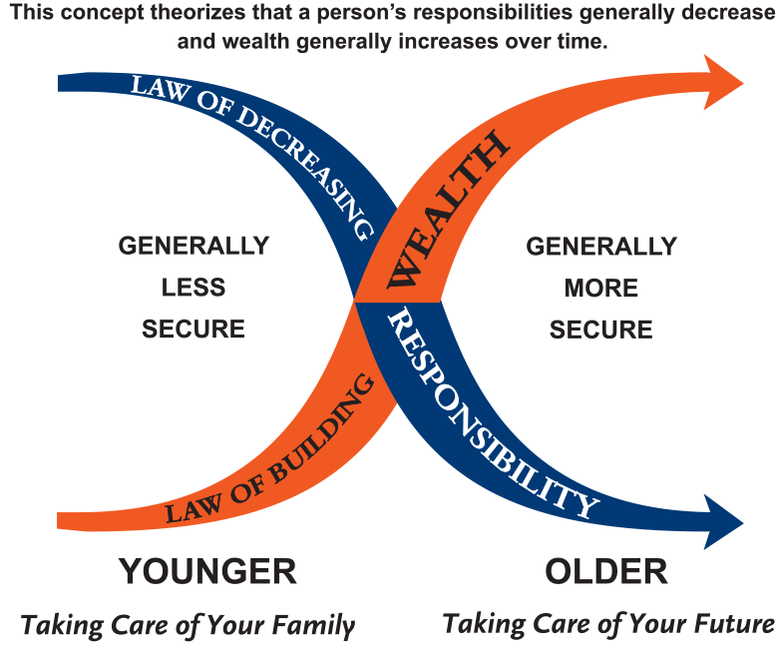
PROTECTION = RISK TRANSFER OR REPLACEMENT
INCOME PROTECTION
SICKNESS
DEATH
JOB LOSS
INJURY

