Slide 1
Suggested Segregated Fund Mix
Prudent Mix | Moderate Mix | Balanced Mix | Growth Mix | Aggressive Mix
100% High Interest Savings Account (HISA) | 50% SRI Moderate (Found under ESG Funds) 50% Indexia Moderate (Found under Indexia Funds) | Mix 1: 30% SRI Balanced (Inhance) (Found under ESG Funds) 35% Global Diversified (Loomis) 35% Strategic Income (2 funds found under Diversified Funds) Mix 2: 40% Strategic Corp Bond (Found in Income Funds) 30% Fidelity Canadian Opportunities (Found in Canadian Equity) 15% Global Equity 15% US Equity Index (BlackRock) (2 funds found in US & International Equity) | 20% Strategic Corporate Bond (Found in Income Funds) 30% Fidelity Canadian Opportunities (Found in Canadian Equity) 25% Global Equity (Found in US & International Equity Funds) 25% US Equity Index (BlackRock) (Found in US & International Equity Funds) | 30% US Equity Index (BlackRock) (Found in US & International Equity Funds) 30% Fidelity Canadian Opportunities (Found in Canadian Equity Funds) 30% Global Equity (Found in US & International Equity Funds) 10% US Daq Index (Found in Specialty Funds)
Canada 33%
USA 30%
Global 37%
(As of Dec 31/23)
Growth/Stocks 30%
Fixed Income 70%
Canada 37%
USA 29%
Global 34%
(As of Dec 31/23)
Growth/Stocks 40%
Fixed Income 60%
Canada 34%
USA 47%
Global 19%
(As of Dec 31/23)
Growth/Stocks 60%
Fixed Income 40%
Canada 26%
USA 59%
Global 15%
(As of Dec 31/23)
Growth/Stocks 80%
Fixed Income 20%
Canada 24%
USA 62%
Global 14%
(As of Dec 31/23)
Growth/Stocks 100%
Fixed Income 0%

Slide 2
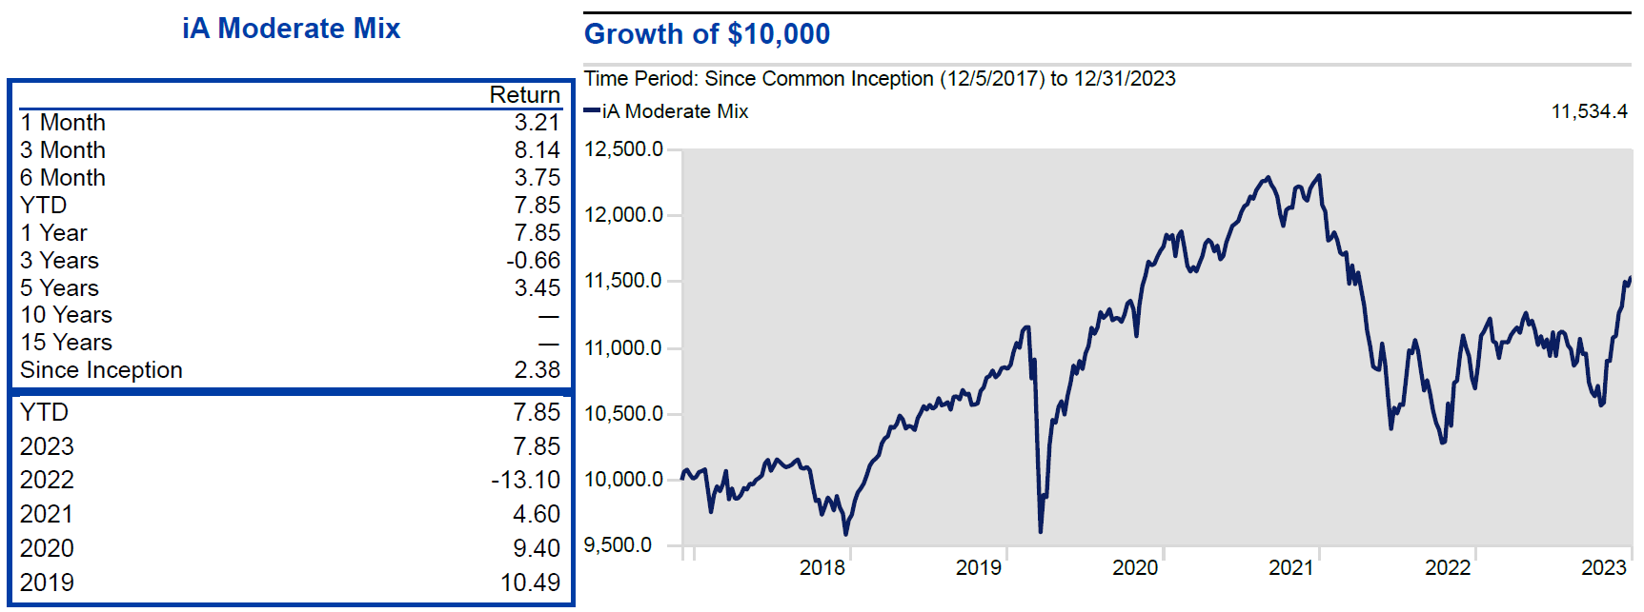
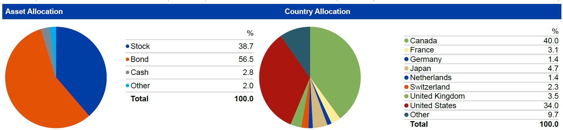
iA Moderate Mix

Slide 3
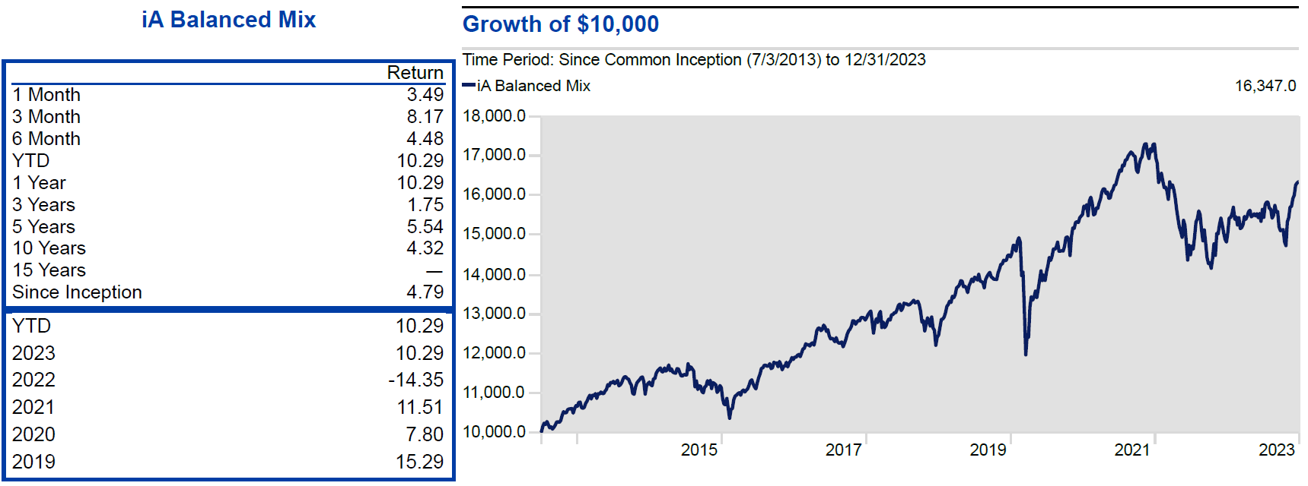
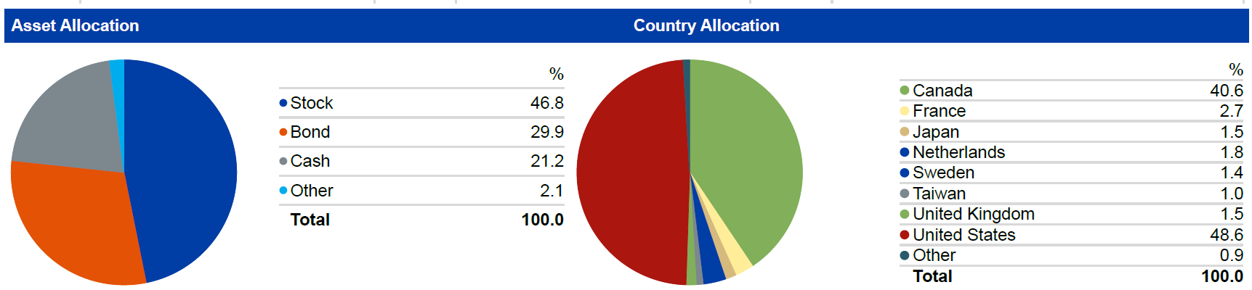
iA Balanced Mix #1

Slide 4
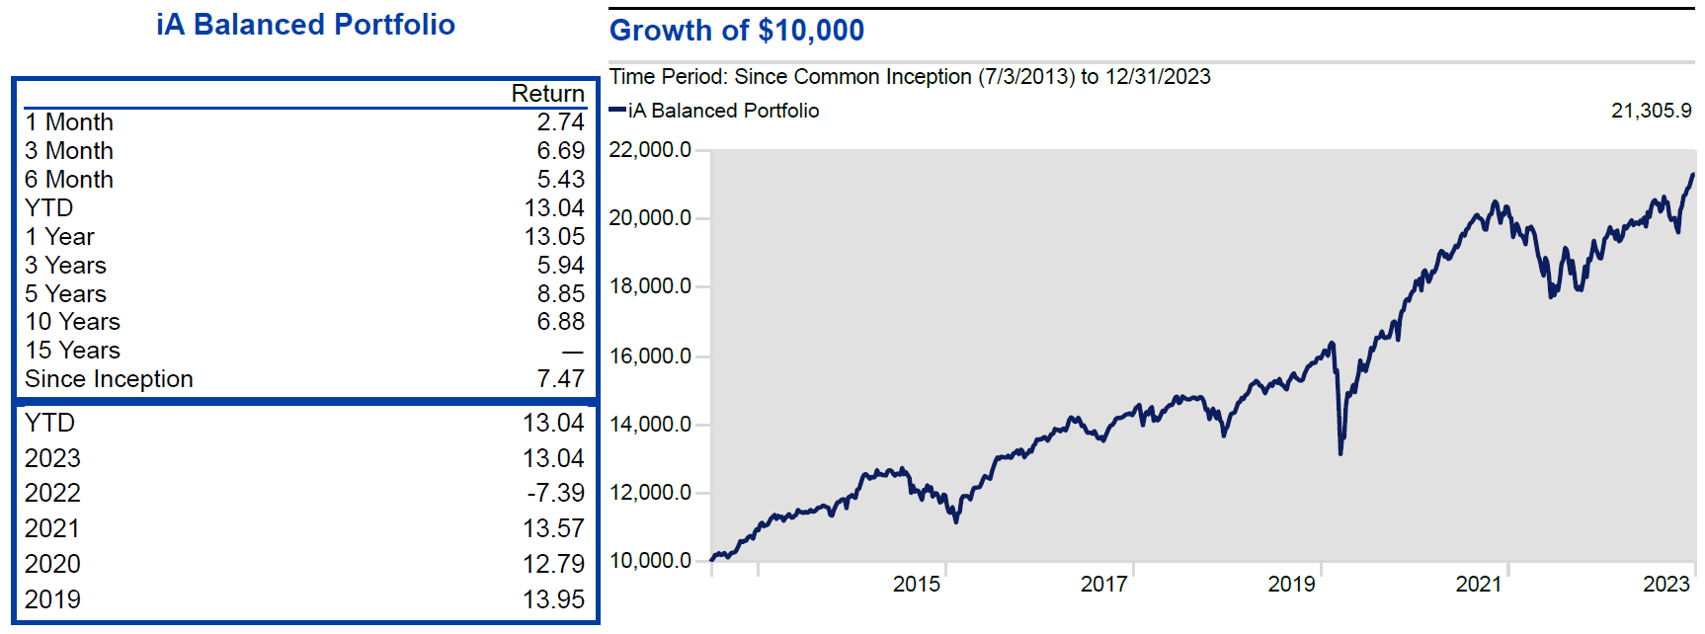
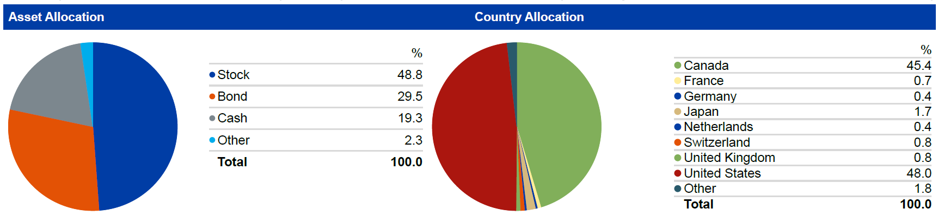
iA Balanced Mix #2

Slide 5
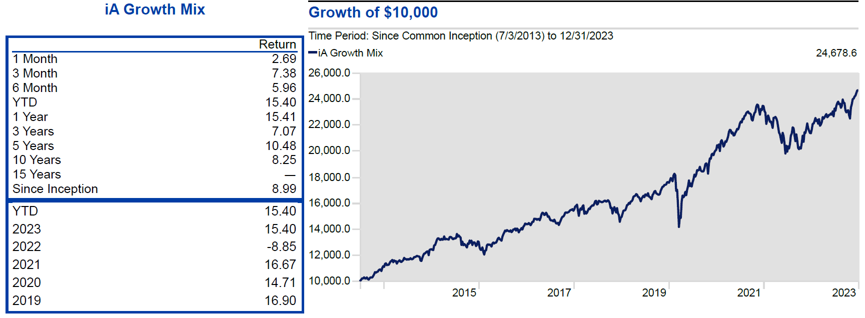
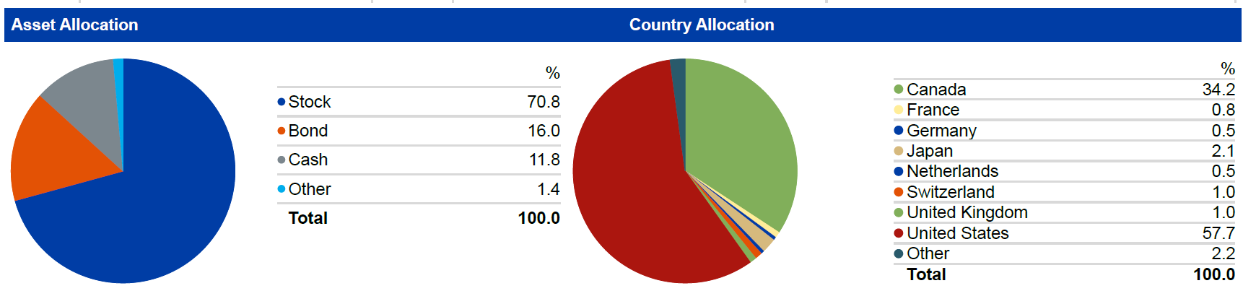
iA Growth Mix

Slide 6
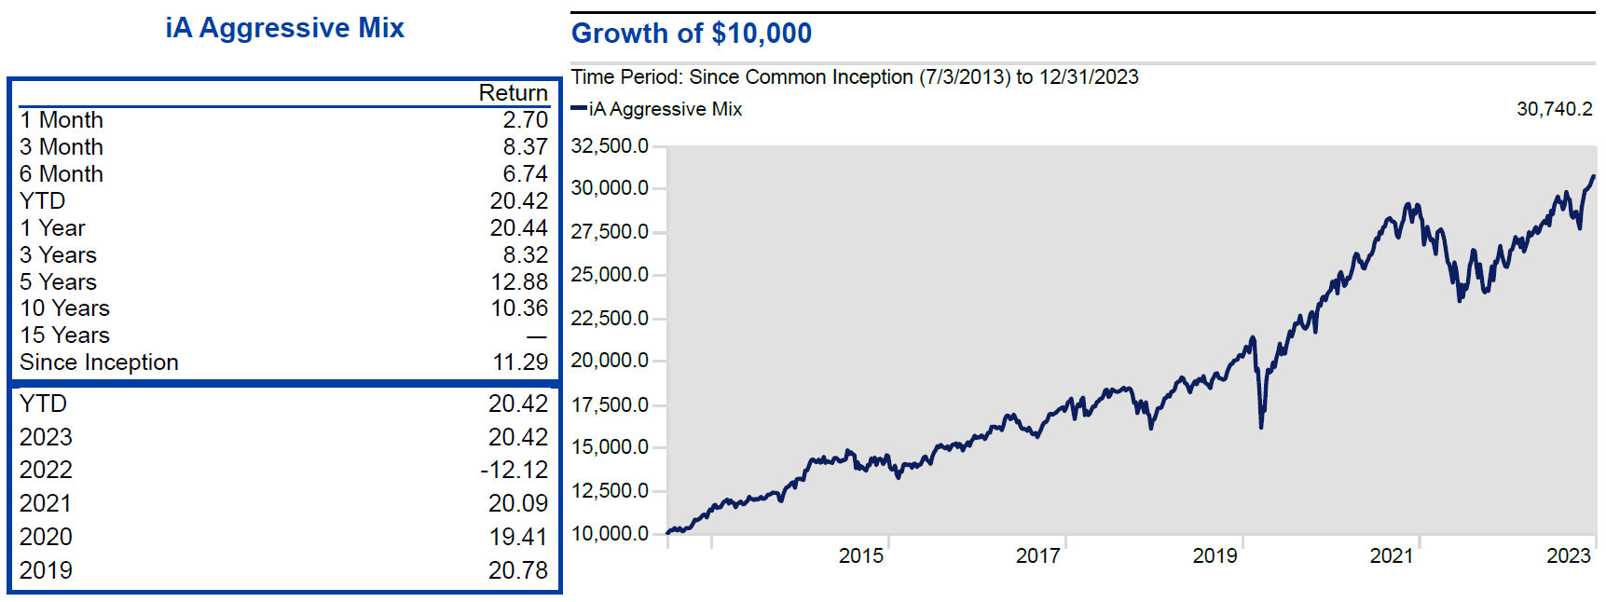
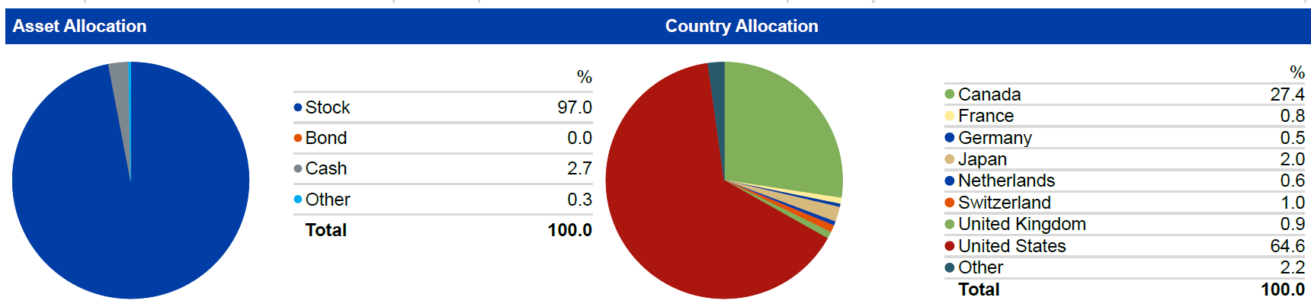
iA Aggressive Mix

Slide 7

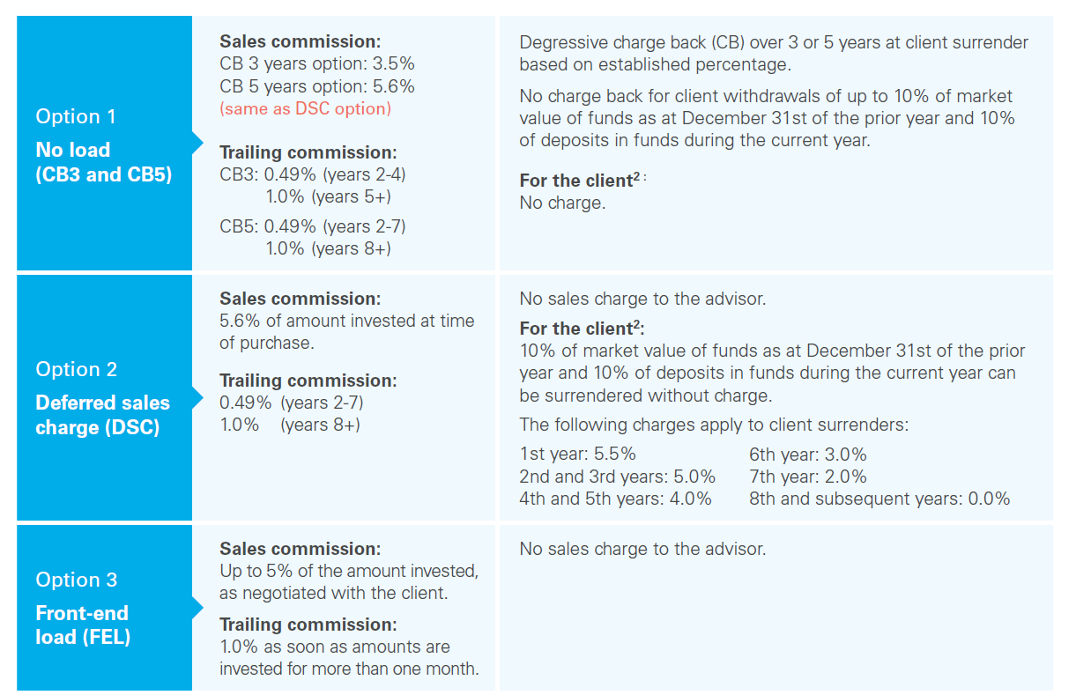
3 Compensation Options

Slide 8
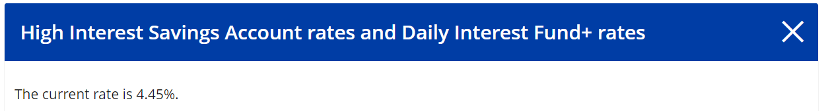
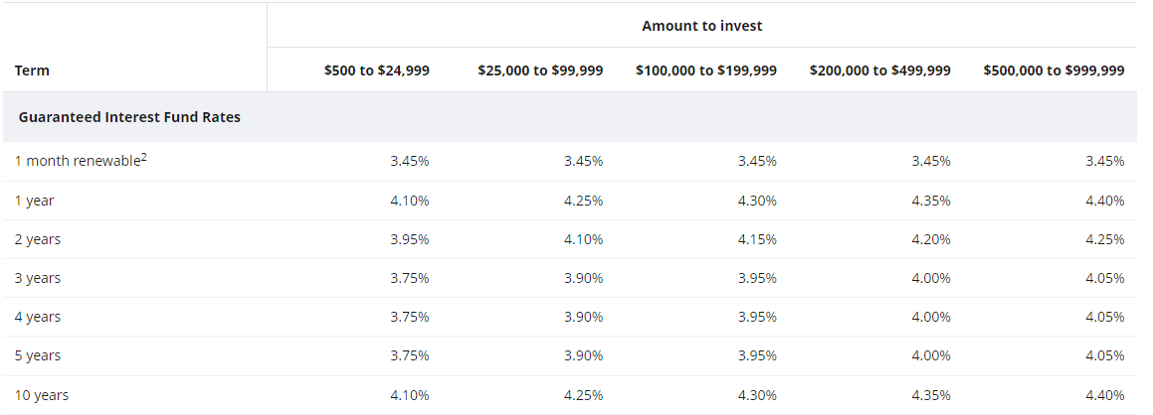
HISA and GIF Rates

